Slide 1
Halloween
Halloween, which until recently widely celebrated only in the U.S., is now gaining popularity in Russia. What we know about this holiday, from where it originates. Is Halloween more to it than just a night when the children dressed in different costumes, collect candy? Halloween - one of the oldest festivals in the world. Its history goes back millennia, from the Celtic festival of Samhain, the Roman Pomona Day (the goddess of plants) and the Christian "All Saints' Day." In a strange way it combines the Celtic tradition of honoring evil spirits and Christian - worship of the saints.

Slide 2
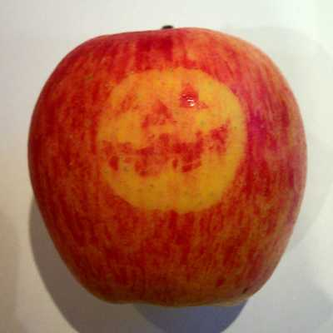
Competition "bite the apple"
Hang the apples from the ceiling on long wires. Divide guests into pairs: two children in each apple. Now ask the children to hold hands crossed behind his back, the signal turns trying to bite an apple. The goal is to manage to bite off from swinging and spinning apple as soon as a bigger piece. That couple, who managed to chew up his apple to the middle for three minutes (use timer) is declared the winner.

Slide 3
