Slide 1
My responsibilities at home
Parents should
give their … more love
set a good example to their …
give their … more freedom
try to understand their …
Children should
do their home work
help at home
be kind, polite and obedient

Slide 2
I help at home
Clean my room
Vacuum the carpet
Water the plants and flowers
Go shopping
Cook
Take care of …
Feed …
Take the pet out / walk the pet
Look after my younger sister/ brother

Slide 3
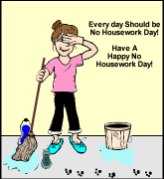
My responsibilities at home
I am a good
(not very g… / bad) son / daughter
always
sometimes ← Help!!!
often
seldom
never

Slide 4
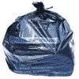

Slide 5
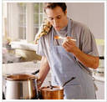
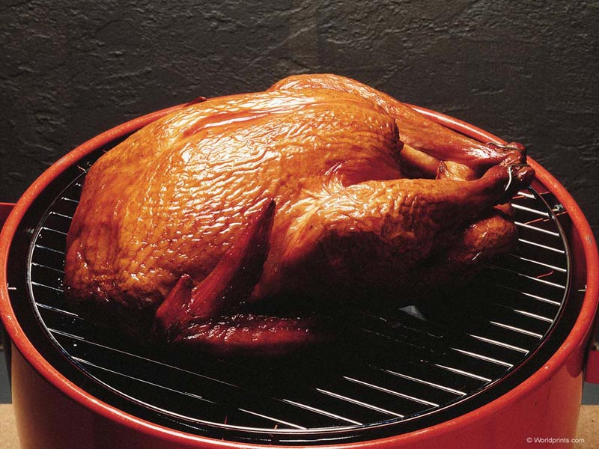

Slide 6
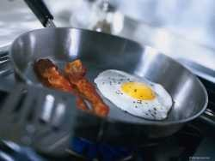
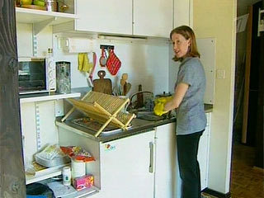

Slide 7
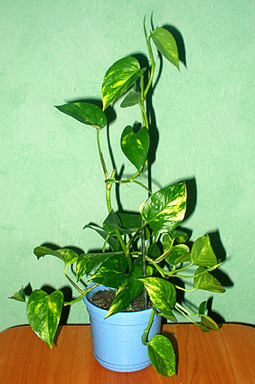

Slide 8
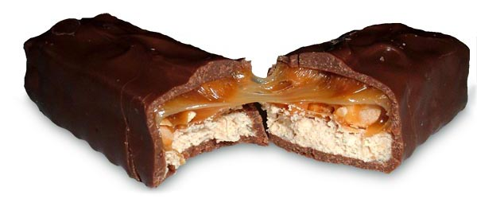
share … with my sister/brother
read him/her fairy-tales

Slide 9
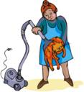
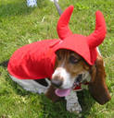
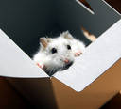

Slide 10
